Slide 1
PREDICTION OF PROMOTER & REGULATORY ELEMENTS
By
Aparna Patil Kose
Lecturer
Dept of Bioinformatics

Slide 2
INTRODUCTION
Promoters are DNA elements located in the vicinity of gene start sites (which should not be confused with the translation start sites) and serve as binding sites for the gene transcription machinery, consisting of RNA polymerases and transcription factors.
Therefore, these DNA elements directly regulate gene expression.
Promoters and regulatory elements are traditionally determined by experimental analysis but; time consuming and laborious.
Thus Computational approach to solve the problem and enhance the potential to replace a great deal of extensive experimental analysis.

Slide 3
Problems
Computationally identification of promoters and regulatory elements is also a very difficult task,
Reasons:
1. Promoters and regulatory elements are not clearly defined and are highly diverse.
2. Every gene have a unique combination of sets of regulatory motifs that determine its unique temporal and spatial expression.
3. Lack of data
4. Promoters and regulatory elements cannot be translated into protein sequences to increase the sensitivity for their detection.
5. Normally elements are short (6 to 8 nucleotide) and found in any sequence by random chance, thus high rate of false positive results because of which sensitivity drops and specificity is hampered.

Slide 4
SOLUTION
Use sophisticated algorithms that give either ab initio–based predictions OR
Predictions based on evolutionary information OR
Experimental data

Slide 5
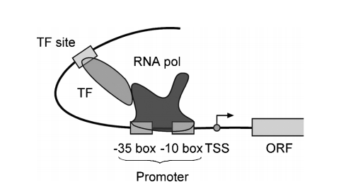
PROMOTER AND REGULATORY ELEMENTS IN PROKARYOTES
In bacteria, transcription is initiated by RNA polymerase, which is a multi-subunit enzyme.
The σ subunit (e.g., σ70) of the RNA polymerase is the protein that recognizes specific sequences upstream of a gene and allows the rest of the enzyme complex to bind.
The upstream sequence where the σ protein binds constitutes the promoter sequence.
This includes the sequence segments located 35 and 10 base pairs (bp) upstream from the transcription start site.
They are also referred to as the −35 and −10 boxes.
For the σ70 subunit in Escherichia coli, for example, the
−35 box has consensus sequence of TTGACA and
–10 box has a consensus of TATAAT

Slide 6
Promoter sequence may determine the expression of one gene or a number of linked genes downstream i.e. OPERON (which is controlled by the promoter)
Along with RNA polymerase, a number of DNA-binding proteins that facilitate the process of transcription which are called as Transcription Factors (TF).
TF bind to specific DNA sequences to either enhance or inhibit the function of the RNA polymerase.
Specific DNA sequences to which the TF bind are referred to as regulatory elements.
The regulatory elements may bind in the vicinity of the promoter or bind to a site several hundred bases away from the promoter.
Regulatory proteins binding at long distance can still exert their effect is because of the flexible structure of DNA, which is able to bend and exert its effect by bringing the transcription factors in close contact with the RNA polymerase complex

Slide 7
PROMOTER AND REGULATORY ELEMENTS IN EUKARYOTES
Gene expression is also regulated by a protein complex formed between transcription factors and RNA polymerase.
However, eukaryotic transcription : are complex as they have three different types of RNA polymerase namely
1. RNA polymerases I (transcription of ribosomal RNAs and tRNAs, respectively)
2. RNA polymerase II (transcribing protein-encoding genes (or synthesis of mRNAs)
3. RNA polymerase III (transcription of ribosomal RNAs and tRNAs, respectively)
Each of them transcribes different sets of genes
Unlike in prokaryotes, where genes often form an operon with a shared promoter, BUT eukaryotic gene has its own promoter.
Requires more transcription factors compared to prokaryotes.
RNA polymerase II does not directly bind to the promoter, but relies on a dozen or more transcription factors to recognize and bind to the promoter in a specific order before its own binding around the promoter.

Slide 8
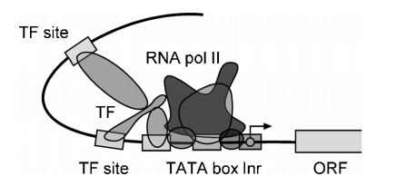
The core of many eukaryotic promoters is a so-called TATA box, located 30 bps upstream from the transcription start site, having a consensus motif TATA(A/T)A (A/T)
However, not all eukaryotic promoters contain the TATA box. Eg: housekeeping genes do not have the TATA box in their promoters.
But still TATA box is often used as an indicator of the presence of a promoter.
Many genes have a unique initiator sequence (Inr), which is a pyrimidine rich sequence with a consensus (C/T)(C/T)CA(C/T)(C/T).
This site coincides with the transcription start site.
Mostly transcription factor binding sites are located within 500 bp upstream of the transcription start site.
Some regulatory sites can be found 10 of 1000 bp away from the gene start site.
Regulatory elements are located downstream instead of upstream of the transcription start site.

Slide 9
PREDICTION ALGORITHMS
Algorithm are categorized as either;
Ab initio based (de novo predictions by scanning individual sequences)
Similarity based (Predictions based on alignment of homologous sequences)
Expression profile based (using profiles constructed from a number of coexpressed gene sequences from the same organism)
Phylogenetic footprinting
RNA polymerase II transcribes the eukaryotic mRNA genes, most algorithms are thus focused on prediction of the RNA polymerase II promoter and associated regulatory elements

Slide 10
Ab Initio–Based Algorithms
Predicts prokaryotic and eukaryotic promoters and regulatory elements based on characteristic sequences patterns for promoters and regulatory elements.
Some algo. depends on signals such as TATA box or Shine- Dalgenro sequence, whereas other rely on content information such as hexamer frequencies.
Advantage: the sequence can be applied as such without having to obtain experimental information.
Disadvantage: Training is required, which makes the prediction programs species specific
Difficult to discover new, unknown motifs
Conventional Method: Detection of element via matching a consensus sequence pattern represented by regular expressions or matching a position-specific scoring matrix (PSSM)
But , in either case, the cons ensus sequences or the matrices are relatively short, covering 6 to 10 bases and generates high rates of false positives as a result.
SOLUTION: New algorithm based on NN, ANN, HMM. MLT, Discriminant functions
Focus on the upstream regions (0.5 to 2.0 kb) only, which are most likely to contain promoters
i.e. promoter prediction and gene prediction are coupled.

Slide 11
Prediction for Prokaryotes
In prokaryotic promoter prediction: determination of operon structures, because genes within an operon share a common promoter located upstream of the first gene of the operon. Thus, operon prediction is the key in prokaryotic promoter prediction.
Number of methods available for prokaryotic operon prediction.
BUT set of simple rules (Wang et al) is accurate which relies on two kinds of information: gene orientation and intergenic distances of a pair of genes of interest and conserved linkage of the genes based on comparative genomic analysis i.e. Gene Linkages are focused.
A scoring scheme is developed to assign operons with different levels of confidence.
CLAIMS: Accurate identification of an operon structure, which in turn facilitates the promoter prediction.
This scoring scheme not yet available as a computer program thus can be done manually using the rules, but few program doesn’t accept this approach.

Slide 12
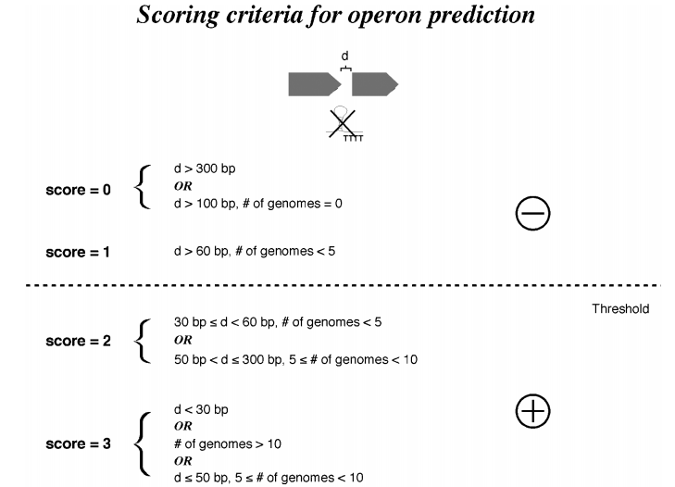

Slide 13
Prediction TOOL for Prokaryotes
BPROM :
is a web-based program for prediction of bacterial promoters.
It uses a linear discriminant function combined with signal and content information such as consensus promoter sequence and oligonucleotide composition of the promoter sites.
1st predicts a given sequence for bacterial operon structures by using an intergenic distance of 100 bp as basis for distinguishing genes to be in an operon.
This rule is more arbitrary than the Wang et al. rule, leading to high rates of false positives.
Once the operons are assigned, the program is able to predict putative promoter sequences.
Because most bacterial promoters are located within 200 bp of the protein coding region, the program is most effectively used when about 200 bp of upstream sequence of the first gene of an operon is supplied as input to increase specificity.
Other Tool: FindTerm, ETC.

Slide 14
Prediction for Eukaryotes
Ab initio method for predicting eukaryotic elements also relies on searching the input sequences for matching of consensus patterns of known promoters and regulatory elements.
The consensus pattern derived from experimentally determined DNA binding sites which are compiled into profiles and stored in a database for scanning an unknown sequence to find similar conserved patterns.
This approach tends to generate very high rate of false positives owing to nonspecific matches with the short sequence patterns.
Also because of the high variability of transcription factor binding sites, the simple sequence matching often misses true promoter sites, creating false negatives.
Thus to increase specificity of prediction unique feature of eukaryotic promoter is employed, which is the presence of CpG islands (many vertebrate genes are characterized by a high density of CG dinucleotides near the promoter region overlapping the transcription start site )
Thus CpG island identification can lead to trace promoter on the immediate upstream region from the islands.
Thus CpG islands and other promoter signals program,can be combined , so the accuracy of prediction can be improved.

Slide 15
Prediction TOOL for Eukaryotes
TSSW :
is a web program that distinguishes promoter sequences from non-promoter sequences based on a combination of unique content information such as hexamer/trimer frequencies and signal information such the TATA box in the promoter region.
The values are fed to a linear discriminant function to separate true motifs from background noise.
Other Tools: McPromoter, CpGProD, Eponine, etc…………..

Slide 16
Phylogenetic Footprinting–Based Method
Promoter and Regulatory elements from closely related organisms such as human and mouse are highly conserved.
Conservation: observed at sequence level and at the level of organization of the elements. Thus, comparative analysis can be performed.
Identification of elements that serve crucial functional roles is referred to as phylogenetic footprinting; the elements are called phylogenetic footprints.
Applicable in Prokaryotes as well as Eukaryotes.
Important: selection of organisms for comparison
Caveats/ Red Flags are:
Organisms selected are too closely related (human and chimpanzee), the sequence difference between them may not be sufficient to filter out functional elements.
Organisms evolutionary distances are too long (such as human and fish), long evolutionary divergence may render promoter and other elements undetectable
To extract noncoding sequences upstream of corresponding genes and focus the comparison to this region only, which helps to prevent false positives.
Predictive value depends on the quality of the subsequent sequence alignments. Thus advance alignment program is used

Slide 17
Thus software programs specifically designed to take advantage of the presence of phylogenetic footprints to make comparisons among a number of related species to identify putative transcription factor binding sites
Advantage: No training of probabilistic models is required
TOOLS:
1. rVISTA
2. ConSite
3. PromH(W)
ETC……………..

Slide 18
Expression Profiling–Based Method
High throughput transcription profiling analysis, such as DNA microarray analysis------Helped in analysis of 100 to 1000 and more gene expression.
Genes with similar expression profiles are considered coexpressed, which can be identified through a clustering approach.
Basis of coexpression ---------is thought to be due to common promoters and regulatory elements and if assumption is valid, the upstream sequences of the coexpressed genes can be aligned together to reveal the common regulatory elements recognizable by specific transcription factors.
Approach is experimentally based and appears to be robust for finding transcription factor binding sites.
But, regulatory elements of coexpressed genes are usually short and weak thus patterns are difficult to predict using simple multiple sequence alignment approaches.
Thus advanced alignment-independent profile construction method such as EM (motif extraction, finds motifs by repeatedly optimizing a PSSM through comparison with single sequences) and Gibbs motif sampling (uses a similar matrix optimization approach but samples motifs with a more flexible strategy and may have a higher likelihood of finding the optimal pattern) is used to find subtle sequence motifs.

Slide 19
Drawbacks:
Determination of the set of co expressed genes depends on the clustering approaches, which are known to be error prone i.e quality of the input data may be questionable when functionally unrelated genes are often clustered together.
In addition, the assumption that coexpressed genes have common regulatory elements is not always valid.
Many coexpressed genes have been found to belong to parallel signaling pathways that are under the control of distinct regulatory mechanisms. Therefore, caution should always be exercised when using this method.
TOOLS:
MEME
AlignACE
Melina ETC…………….

Slide 20
THANK
YOU

